Slide 1

aol
Logo Designed by
Terry Watkins

Slide 2

Platinum & Venue Sponsor
@uspto

Slide 3
aol
Logo Designed by
Terry Watkins

Slide 4
Wednesday Schedule at a Glance
9:00 – Keynotes
10:35 – Morning Break
12:05 – Ignite Talks
12:20 – Open Space Agenda
1:00 – Lunch
2:00 – Ignite Talks
2:20 – Open Spaces
3:30 – Afternoon Break
4:50 – Evening News
6:00 – Happy Hour at the Carlyle Club

Slide 5

Happy Hour Sponsor
@opsgenie

Slide 6

Happy Hour Sponsor
@aol_inc

Slide 7
aol
Logo Designed by
Terry Watkins

Slide 8


Staff & Volunteers

Slide 9

Platinum Sponsor
@pivotal
Notes:
Need High Res Logo

Slide 10

Platinum Sponsor
@cloudpassage

Slide 11

Platinum Sponsor
@netuitive

Slide 12
Etherpad
e.devopsdaysdc.org
We Are Hiring
Looking for Work
Reading List
Social Media
Feedback on DevOpsDays DC

Slide 13
Platinum Sponsor
@capitalone

Slide 14

Platinum Sponsor
@_eglobaltech

Slide 15

Platinum Sponsor
@excellaco

Slide 16
Etherpad
e.devopsdaysdc.org
We Are Hiring
Looking for Work
Reading List
Social Media
Feedback on DevOpsDays DC

Slide 17

Platinum Sponsor
@solarwinds

Slide 18
Platinum Sponsor
@csra_inc

Slide 19

Platinum Sponsor
@docker

Slide 20
Thursday Schedule at a Glance
9:00 – Keynotes
10:25 – Morning Break
11:55 – Ignite Talks
12:25 – Open Space Agenda
1:00 – Lunch
2:00 – Open Spaces
4:15 – DevOpsDays Podcast

Slide 21

Platinum Sponsor
@chef

Slide 22
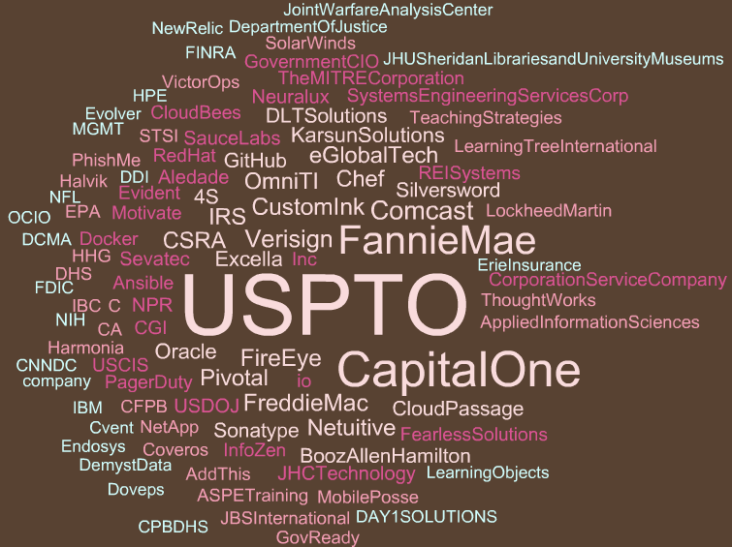

Slide 23

Platinum Sponsor
@thoughtworks

Slide 24

Platinum Sponsor
@pagerduty

Slide 25

Happy Hour – Wednesday 6:00PM

Slide 26

Platinum Sponsor
@github

Slide 27

Platinum Sponsor
@customink

Slide 28

Platinum Sponsor
@redhatsoftware

Slide 29

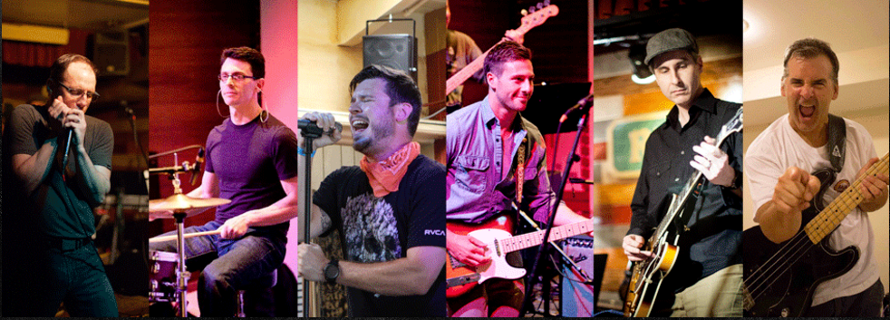

Slide 30

Platinum Sponsor
@ansible

Slide 31

Platinum Sponsor
@dltsolutions

Slide 32

Platinum Sponsor
@omniti

Slide 33
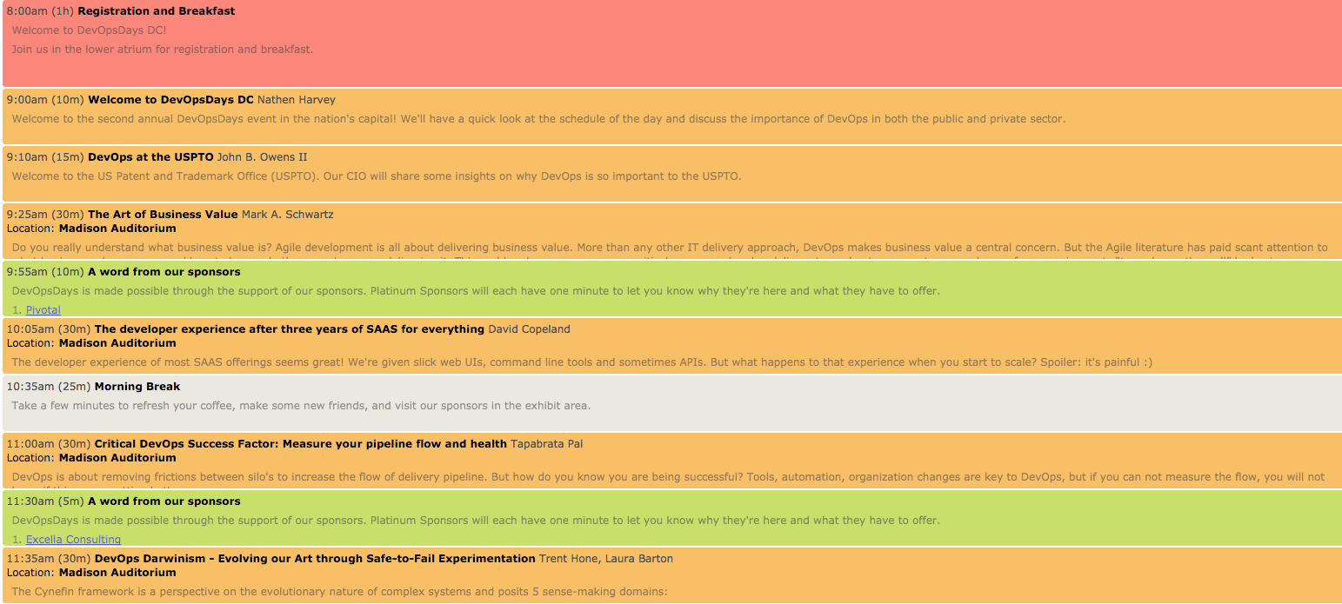
Wednesday Morning

Slide 34

Platinum Sponsor
@aspe_inc

Slide 35

Platinum Sponsor
@saucelabs

Slide 36
aol
Logo Designed by
Terry Watkins

Slide 37
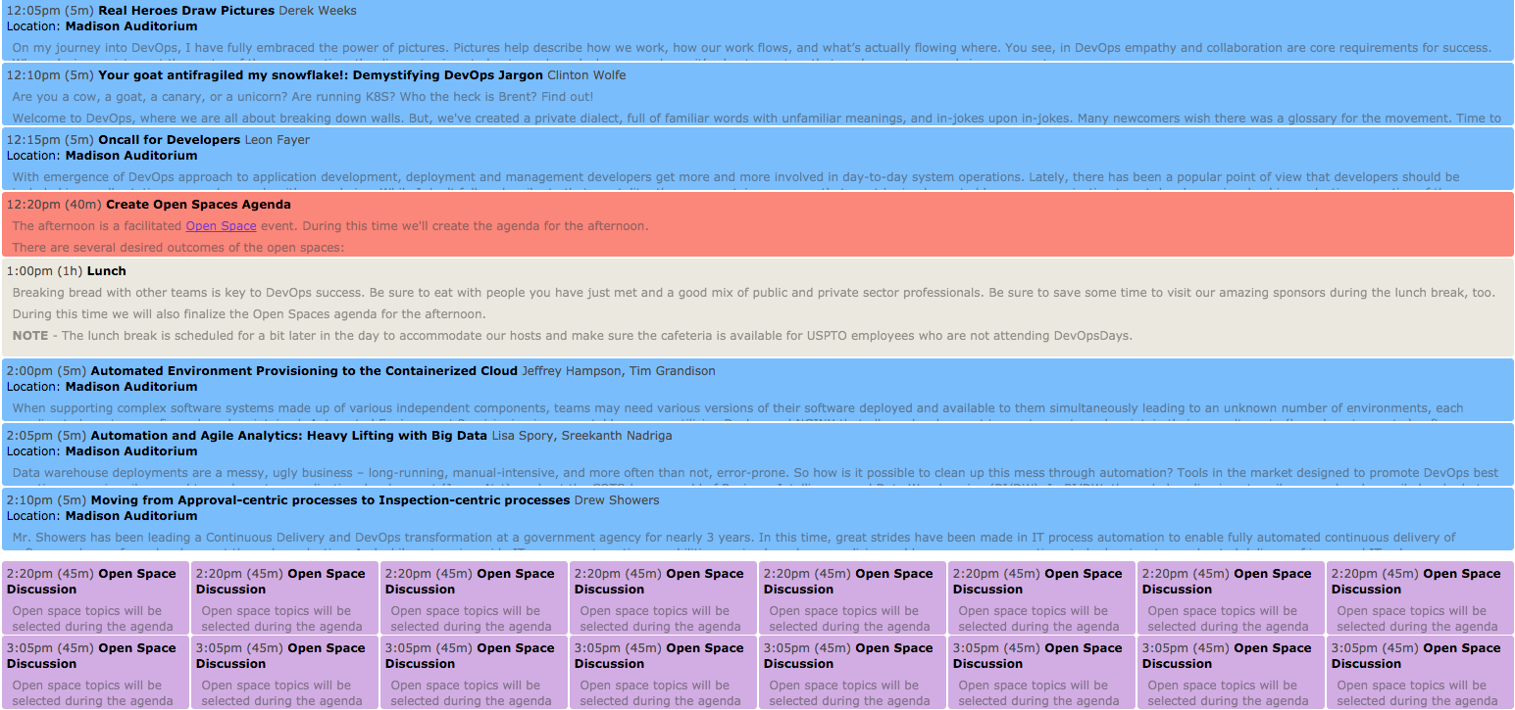
Wednesday Afternoon

Slide 38

Gold Sponsor
@infozencorp

Slide 39

Gold Sponsor
@comcast

Slide 40

Gold Sponsor
@karsunllc

Slide 41
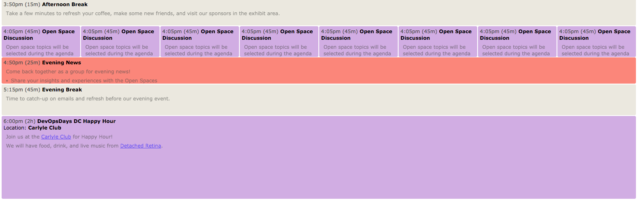
Wednesday Afternoon & Evening

Slide 42

Gold Sponsor

Slide 43
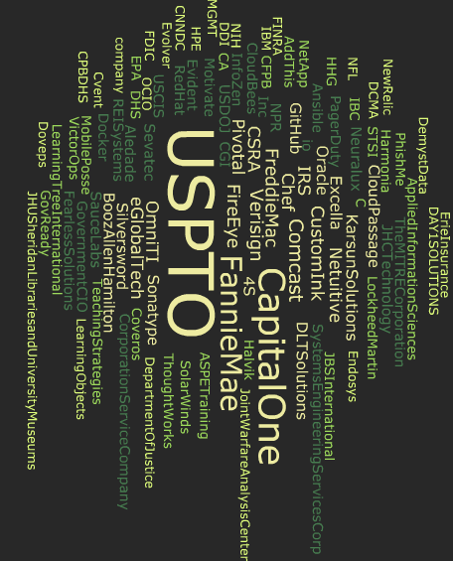

Slide 44

Gold Sponsor
@evidentdotio

Slide 45

Gold Sponsor
@victorops

Slide 46
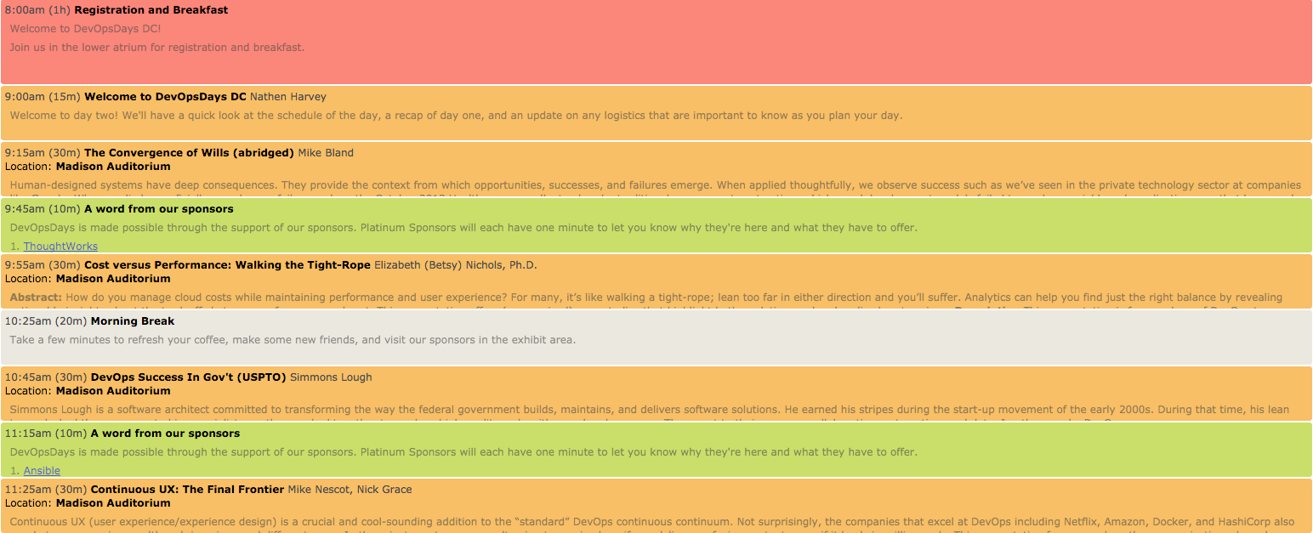
Thursday Morning

Slide 47

Gold Sponsor
@cloudbees

Slide 48
Gold Sponsor
@fanniemae

Slide 49
aol
Logo Designed by
Terry Watkins

Slide 50
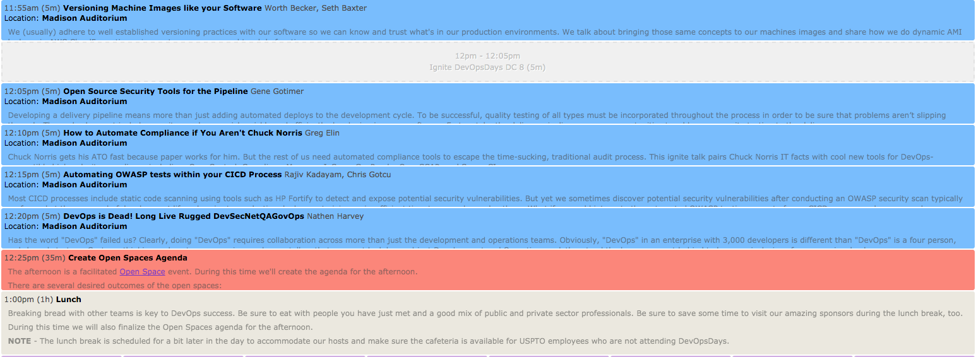
Thursday Afternoon

Slide 51

Silver Sponsor
@sonatype

Slide 52

Silver Sponsor
@halvikcorp

Slide 53

Silver Sponsor
@jhctechnology

Slide 54
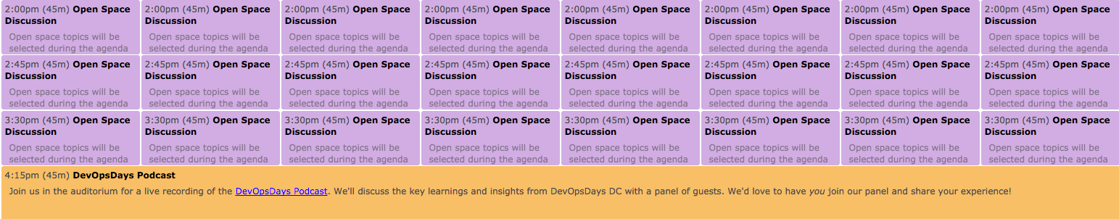
Thursday Afternoon

Slide 55

Silver Sponsor
@stsiinc

Slide 56

Silver Sponsor
@phishme

Slide 57

Silver Sponsor
@govready

Slide 58

August 16-17

Slide 59

Silver Sponsor
@solidfire

Slide 60

Silver Sponsor
@fearlesssol

Slide 61

Silver Sponsor
@aisteam

Slide 62
